Slide 1
Cloud mask algorithm comparison
GEE vs COLAB

Slide 2
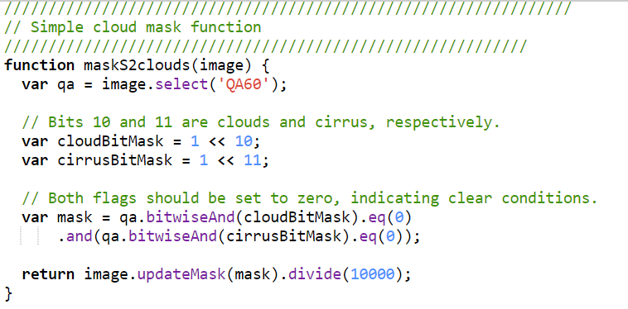
Cloud mask algorithm comparison
GEE has a simple method to mask out clouds on Sentinel-2 based on the cloud bit mask on the QA band

Slide 3
Cloud mask algorithm comparison
In many cases, that simple algorithm implemented in GEE using the QA band is not enough, and more efficient and accurate cloud mask needs to be employed
An available cloud mask algorithm using the cloudless collection as well as probability of clouds allows not only to better identify clouds, but also mask out cloud shadows.
Its drawback is that GEE used to give memory error issues when using it.
Solution, run it in COLAB.

Slide 4
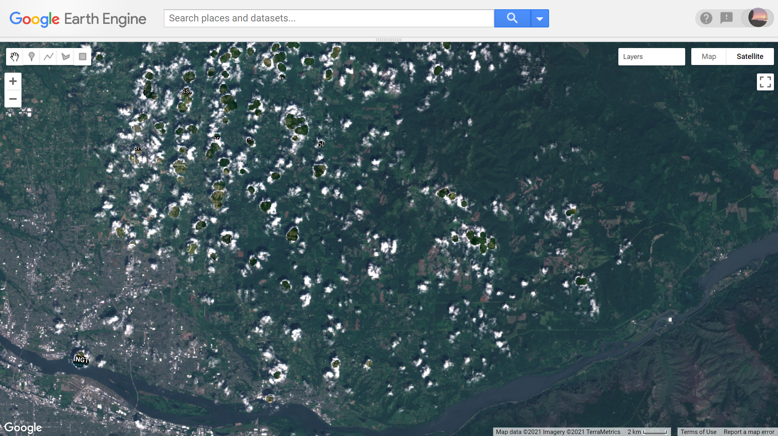
Cloud mask comparison : GEE simple script
Most of the clouds are not totally masked and will have an imminent impact on its derived
products

Slide 5
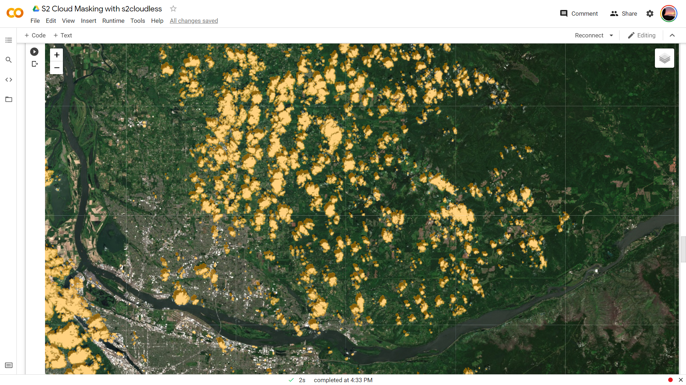
Cloud mask comparison: COLAB advanced
In this case, the majority of clouds are properly masked, including also their cloud shadows

Slide 6
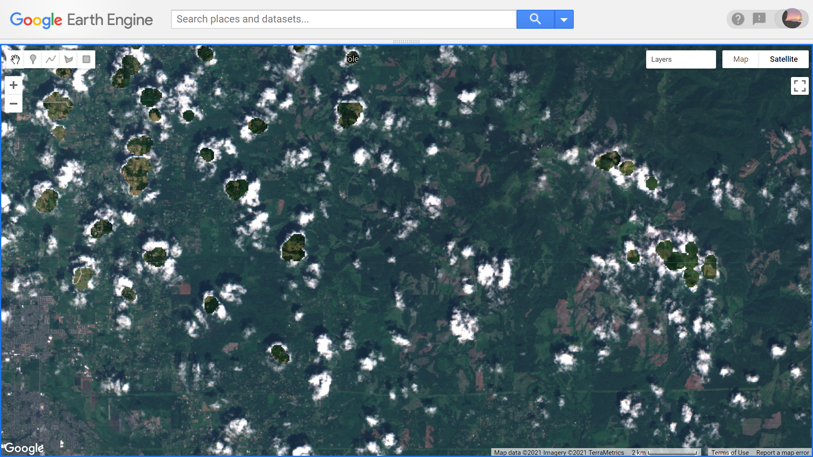
Zoom on GEE cloud mask

Slide 7
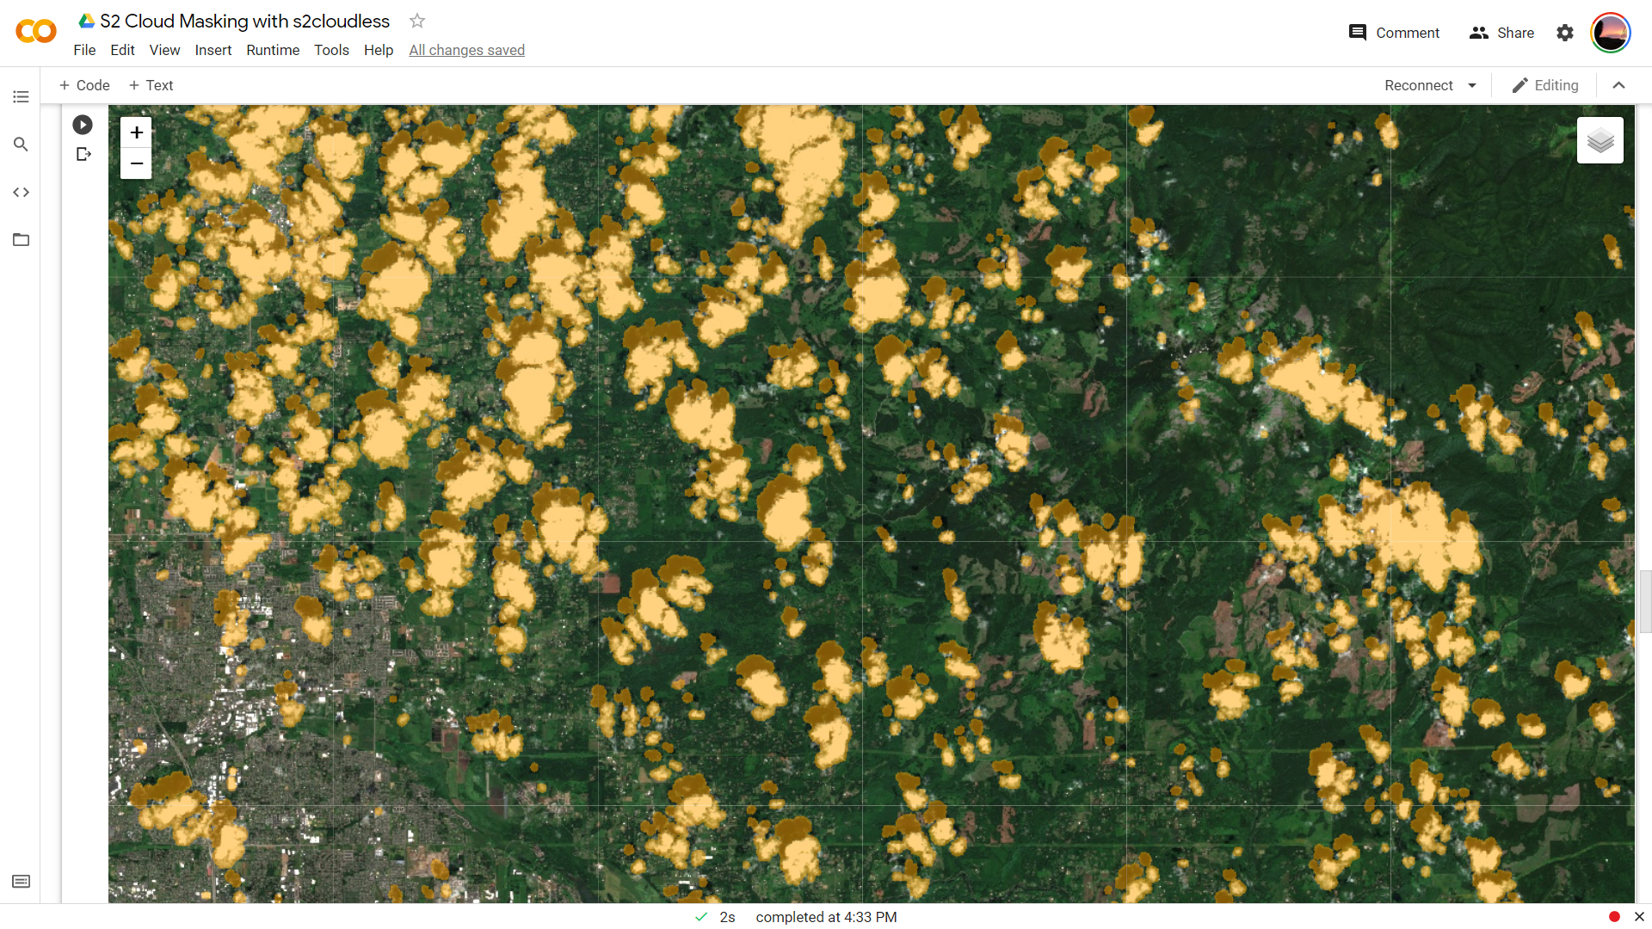
Zoom on COLAB cloud mask

